Slide 1

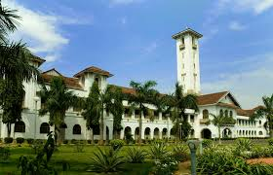
Why do we fail?
What helps us bounce back?
Manas K Mandal

Slide 2
Question yourself…
Describe the last time you got really stressed at study: why were you stressed? How did you cope? What happened at the end? Could you avoid this stress in future?
Describe a time when someone else put pressure on you: How did you feel about that? Did everything work out? Did you handle the pressure as you wanted to?
What has been your greatest failure? How did you feel? How did you cope? What would you do differently next time?
@Manas K Mandal

Slide 3
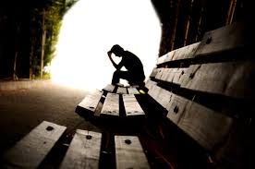
Why do we fail…?
Keeping ‘success only’ in mind vs ability to ‘bounce back’
Inability to aim above mediocrity vs having a goal challenging enough
Overemphasis on best ideas vs dwelling on alternatives
Having a ‘right’ idea vs getting idea ‘right’
Having optimism vs having optimism ‘bias’
@Manas K Mandal

Slide 4
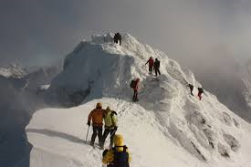
…factors that contribute to failure?
Risk taking: Seeking risk is critical
Tool seduction: Failures are more often due to over-reliance on tools
Arrogance: It happens as one hallucinates about his own greatness
Shift in focus: A shift from ‘thinking big’ to doing ‘micro-management’
@Manas K Mandal

Slide 5
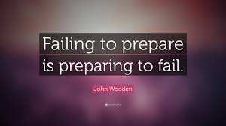
…factors that contribute to failure
Lone heroism: It demoralizes team
Comfort: It sabotages greatness
Luck: Failure occurs in pure luck but not in skill-based luck
Poor self-regulation: Lack of control on energy expenditure
@Manas K Mandal

Slide 6
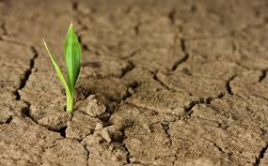
Resilience
It’s a process of adapting well in face of adversity, Trauma, threat or tragedy. It means ‘bouncing back’ from difficult experiences (APA)
Research has shown that it is an ordinary rather than an extra-ordinary behavior
It does not mean they do not experience difficulty or distress
Its not a trait that people either have or do not have. It involves behaviors, thoughts, & actions that can be learned or developed in anyone
@Manas K Mandal

Slide 7
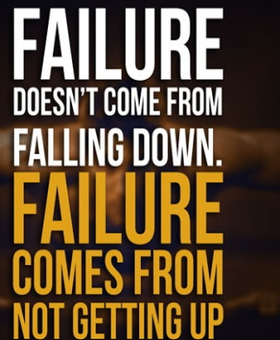
The resilient people…
They understand that all things are temporary
They look at obstacles as challenges to be overcome & take decisive actions
They have clear & distinct boundaries in their relationships
Their anger is paired with determined action
They identify themselves as survivors & not a victim
They have strong sense of internal locus of control
@Manas K Mandal

Slide 8
Resilience theories…
Michel Rutter, 2006
It is more than social competence or positive mental health; competence must exist with risk to be resilient
It is not related to individual traits or superior functioning; it is an ordinary adaptation to right resources
It is the environment, not the person, that is the catalyst for individual differences
Turning point experiences are significant since these bring discontinuity & bring new options
@Manas K Mandal

Slide 9
Resilience theories…
Norman Garmezy, 1991
Functional adequacy despite interfering emotionality is the benchmark
It is linked to low number of risks & higher number of protective factors
Three factors in togetherness lead to resilience: dispositional attributes, family cohesion & warmth, support factors from larger community
@Manas K Mandal

Slide 10
Resilience theories…
Suniya Luther, 2000
Resilient people have exposure to stress, threat & the achievement of positive adaptation
It is not a personal trait but a product of interaction of individual & environment
Neural mechanism, like cortico-limbic pathways have a role in resilience
@Manas K Mandal

Slide 11
Resilience theories…
Ann Masten, 2011
Resilience is ‘ordinary magic’: individuals do not withstand risk but change to accommodate risk
It is a dynamic system to adapt successfully to stressors that threaten system function
@Manas K Mandal

Slide 12
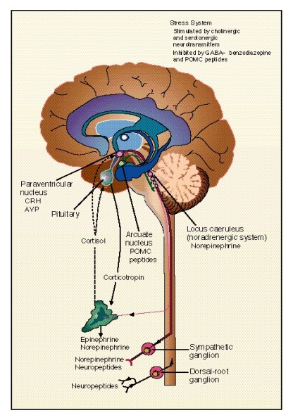
Biology of resilience…
Hypothalamus-pituitary-adrenal axis release cortisol under stress that protects & promotes adaptation
Hormone Neuropeptide Y has anxiolytic effect in brain & enhance cognition under stress
Oxytocin & social support have similar and additive stress-buffering effect; removes subjective effects of stress
Effects of oxytocin are stronger in women
@Manas K Mandal

Slide 13

The resilient people…
They self regulate and set boundaries
Self-regulation is about the ability to maintain emotional, cognitive & behavioral control, during times of stress
Failure is not an indication that something is wrong permanently
They believe that they can change the situation, rather than assuming that it is fixed
@Manas K Mandal

Slide 14
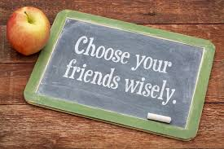
The resilient people…
They keep good company
They tend to surround themselves with other resilient people
Social support & sense of community are major contributor to resilience
Loneliness after failure often contribute to emotional trauma & recovery becomes difficult
@Manas K Mandal

Slide 15
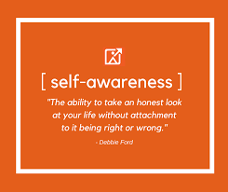
The resilient people…
They cultivate self-awareness
It helps being aware of psychological needs
They are good at sensing subtle needs of body & mind
They remain flexible & do not develop emotional glaciers, just to appear strong
They are not prone to stress fractures in face of unexpected change in life
@Manas K Mandal

Slide 16
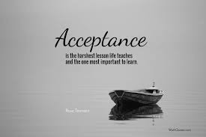
The resilient people…
They practice acceptance
They accept pain & the truth in it
They do not defend unnecessarily or try to ignore or repress it
They understand that acceptance is not about giving up & let stress take over
They witness & experience the full range of emotions & absorb lessons, only to bounce back
@Manas K Mandal

Slide 17
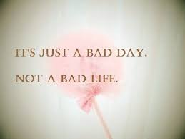
The resilient people…
They consider possibilities
They can change their thought; look at in a different way that they were not considering
Their understanding of situation is not colored by instant reaction or current interpretation
They can find reprieve by getting stressful thoughts out of head
They maintain a positive outlook
@Manas K Mandal

Slide 18
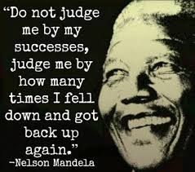
@Manas K Mandal

